Slide 1



AI POWERED
MULTILINGUAL TRANSLATOR
By: Deep Srivastava

Slide 2


Overview
Introduction
01
About us
02
Our Services
03
Strategy
04
Experience
05
Project Timeline
06
Strategy
07
08

Slide 3

Introduction
Language remains one of the greatest barriers to cross-cultural communication. While online translation services like Google Translate are effective, they are dependent on internet access, raise privacy concerns, and are not always viable in restricted or remote environments.
This project addresses those challenges by building an offline multilingual translator using the NLLB-200 distilled model by Meta AI. The application is developed in Python, leveraging Tkinter for a lightweight GUI, and supports real-time text translation across various widely spoken languages — all executed locally on the user’s system without the need for internet access.

Slide 4
About
Hello Everyone,
This is Deep Srivastava
Currently Pursuing my B.Tech DegreeFrom United
College Of Engineering And Research, affiliated to
AKTU, Lucknow.
This Project was assigned To me By Our Gen-AI Mentor
Mr. Rushikesh Jagtap.
Project Is About A Multi-Lingual Translator using
Generative AI.

Slide 5

Objectives
Objective 01
Objective 02
Objective 03
Objective 04
To implement a real-time translation system that functions entirely offline.
To integrate the NLLB-200 distilled multilingual model into a desktop application.
To ensure support for multiple global languages through efficient dropdown selection and input/output fields.
To provide a
simple, user-friendly GUI using Tkinter.

Slide 6
Tools & Technologies Used
Component | Description
Machine Learning Model | Python 3.10+
Machine Learning Model | NLLB-200 Distilled Model (Meta AI)
GPU Framework | Tkinter (ttk for styling)
NLP Libraries | transformers, torch
Environment | Local execution (offline capable)
IDE | Visual Studio Code

Slide 7

KEY FEATURES
🌐 Multilingual Support
Bi-directional translation between over 10 languages.
🖥️ User-Friendly GUI
Styled with modern fonts, color-coded areas, and intuitive layouts.
🔁 Reversible Translation Easily switch between source and target languages.
⚡ Optimized for Speed Uses a distilled version of the NLLB-200 model for faster response
✅ Offline Translation
No internet is required after initial setup.
🔒 Privacy Safe
Entire translation workflow is processed locally

Slide 8

English (eng_Latn)
French (fra_Latn)
Hindi (hin_Deva)
Spanish (spa_Latn)
Bengali (ben_Beng)
Tamil (tam_Taml)
Telugu (tel_Telu)
Arabic (arb_Arab)
Russian (rus_Cyrl)
Chinese (zho_Hans)
Japanese (jpn_Jpan)
01
02
03
04
Supported
Languages
05
06
03
07
08
04
09
10
11

Slide 9
System Architecture
GUI Design and Flow
sql
CopyEdit
+---------------------+
| User Interface | ← Tkinter GUI
+----------+----------+
|
v
+---------------------+
| Language Selection |
+---------------------+
|
v
+-----------------------------+
| Tokenizer + NLLB-200 Model |
+-----------------------------+
|
v
+---------------------+
| Translated Output |
+---------------------+
The modular architecture allows easy future integration of voice input, file-based translation, or web-based interfaces.
The GUI has been carefully crafted for accessibility and clarity. Key design elements include:
mathematica
CopyEdit
┌────────────────────────────────────────────────────────────┐
│ 🌍 Multilingual Translator (Header - Blue) │
├────────────────────────────────────────────────────────────┤
│ [Enter Text Box - White background] │
├────────────────────────────────────────────────────────────┤
│ [Translate From] [Dropdown] [To] [Dropdown] │
│ [🔁 Translate Button] │
├────────────────────────────────────────────────────────────┤
│ [Translation Output Box - Light green background] │
└────────────────────────────────────────────────────────────┘
The layout maintains consistent spacing, intuitive navigation, and visually distinct input/output areas.

Slide 10


CODE OVERVIEW
Model Loading: The application loads the NLLB-200 distilled model and tokenizer from a local folder using AutoTokenizer and AutoModelForSeq2SeqLM.
Translation Engine:
Input text is tokenized based on the source language.
The forced_bos_token_id ensures correct output language alignment.
Output tokens are decoded back to readable text.
GUI Logic:
Tkinter-based interface uses dropdowns and text boxes for user interaction.
On button click, the translate function is triggered, and output is displayed.
Error Handling: All translation logic is wrapped in a try-except block to catch issues and show friendly alerts

Slide 11
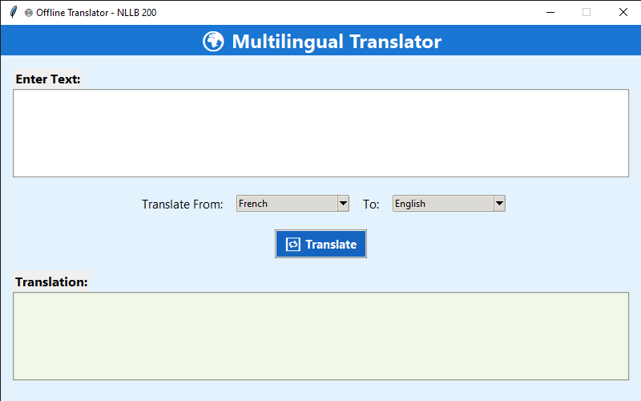
OUTPUT SCREEN

Slide 12
No automatic detection of source language (manual selection required).
Cannot translate documents or multimedia files.
Relatively high RAM usage (~1GB) due to model size.
No voice input/output in current version.
LIMITATIONS

Slide 13
Future Enhancements
🧠 Auto-Language
Detection (e.g., using langdetect or fasttext)
🌓 Theme Options:
Add dark/light mode toggle
📦 Executable Packaging
using PyInstaller for easy installation
📄 File Translation
support (TXT, DOCX)
🗣️ Speech Recognition
& Synthesis
(voice-to-text & text-to-speech)

Slide 14

CONCLUSION
This project successfully demonstrates the deployment of a powerful multilingual NLP model in a desktop environment. It bridges language barriers in offline scenarios, providing accessibility and privacy without relying on third-party cloud APIs.
With a clean GUI, modular code structure, and scalable model backend, the system serves as a practical foundation for educational, governmental, and field-level use cases requiring robust offline translation.

Slide 15

THANK YOU!

